Slide 1

Quant Week 2
09/18/25
Notes:
Complete

Slide 2


Spotlight

Slide 3
Ice Breaker
Favorite flavor (of anything)

Slide 4


Brain Teaser - Bridge and Torch Problem
Bridge and Torch
4 people need to cross a river.
Only 2 people can cross at a time
Person A takes 10 minutes to cross, person B takes 5, C takes 2 and D takes 1.
It’s dark out so no one can cross without a torch.
Only 1 torch.
What is the fastest way to cross, and how long
would it take?

Slide 5
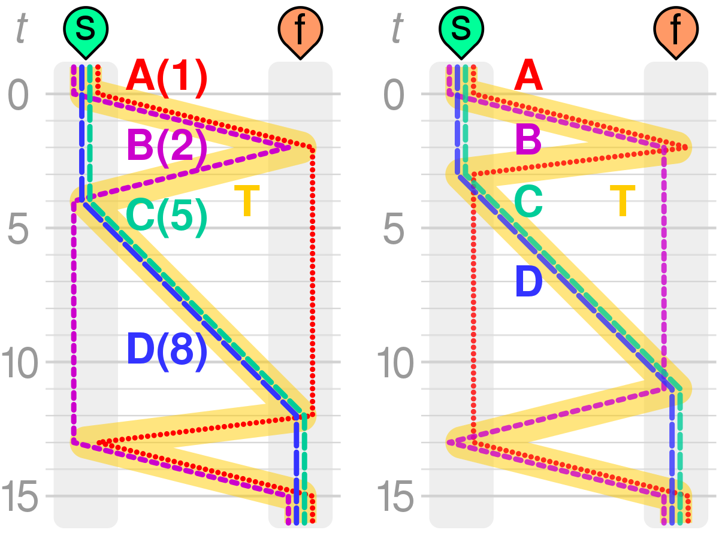
Step 1: D & C Cross First
• D and C cross together, taking 2 minutes.
• Now C & D are on the other side.
Step 2: D Returns with the Torch
• D returns alone, taking 1 minute.
• Now A, B, and D are on the starting side, and C is on the other side.
Step 3: A & B Cross Together
• A and B cross together, taking 10 minutes (since A is the slowest).
• Now A & B are on the other side, and D is still on the starting side.
Step 4: C Returns with the Torch
• C returns alone, taking 2 minutes.
• Now C & D are on the starting side again, and A & B are on the other side.
Step 5: C & D Cross Again
• C and D cross together, taking 2 minutes.
• Now everyone is on the other side.

Slide 6
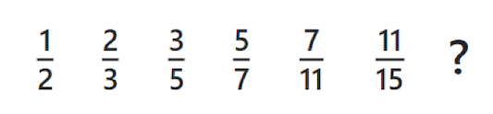
Sequence

Slide 7
Option Greek Values

Slide 8
What are the Greeks?
The Greek values are metrics that are used to determine the performance of options in relation to their overlying asset.
These are the first partial derivatives of various factors influencing the asset value.
The primary greek values are:
Delta Δ, Theta Θ, Gamma Γ, Vega v, and Rho ⍴
Note: Alpha and Beta are not included here.

Slide 9
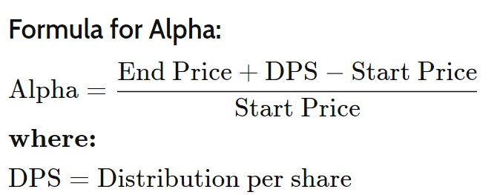
Alpha (not a Greek)
This measures how good/bad a stock has performed compared to a benchmark
Often measured in percentage
Example:
Stock Starting Price: $20
Stock Ending Price: $21
Dividend: $1
Alpha = (21 + 1 - 20) / 20 = 10%
From Investopedia:

Slide 10
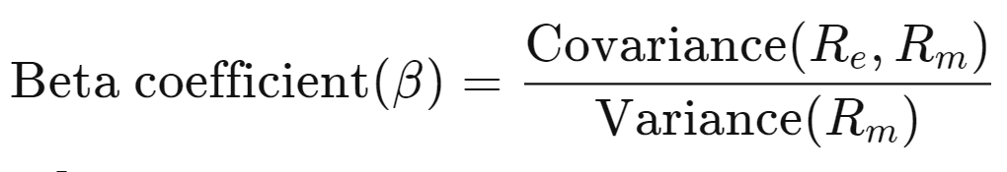
Beta β (not a Greek)
Even though Beta is a greek letter, it is not considered a greek.
It doesn’t represent a partial derivative of the overlying asset like the other values do.
Beta represents the volatility of an asset compared to the rest of the market.
In terms of statistics, this is very similar to variance but is normalized to the market as a whole
A beta of greater than 1 means the asset is more volatile than the market
A beta of less than 1 means the asset is less volatile than the market

Slide 11
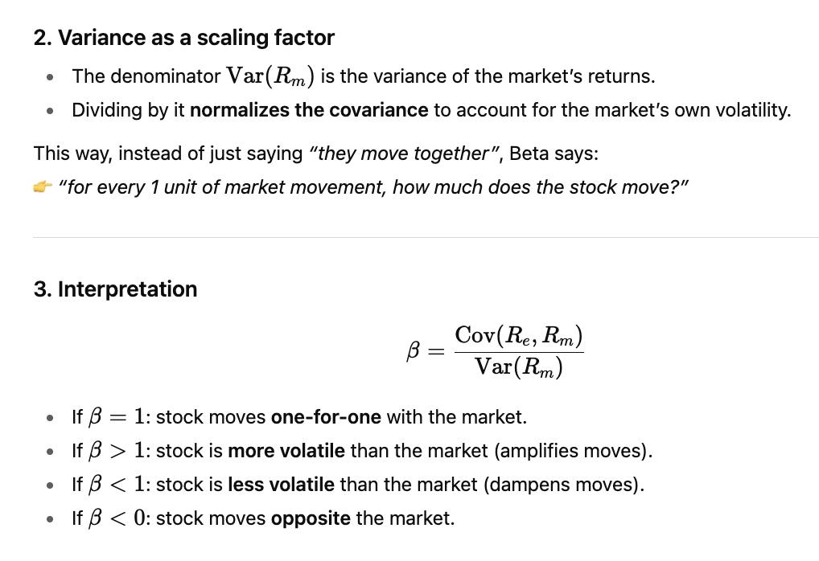
Beta β (not a Greek)

Slide 12
Delta Δ
Estimates the change in price of the derivative/option based on a $1 move in the price of the underlying asset
This value is typically not above 1.0
Example,
A stock price increases by $2.
A call option with a strike price of $80 that is currently trading at $20 has a delta of 0.8 What will the new price of this be?
$21.60

Slide 13
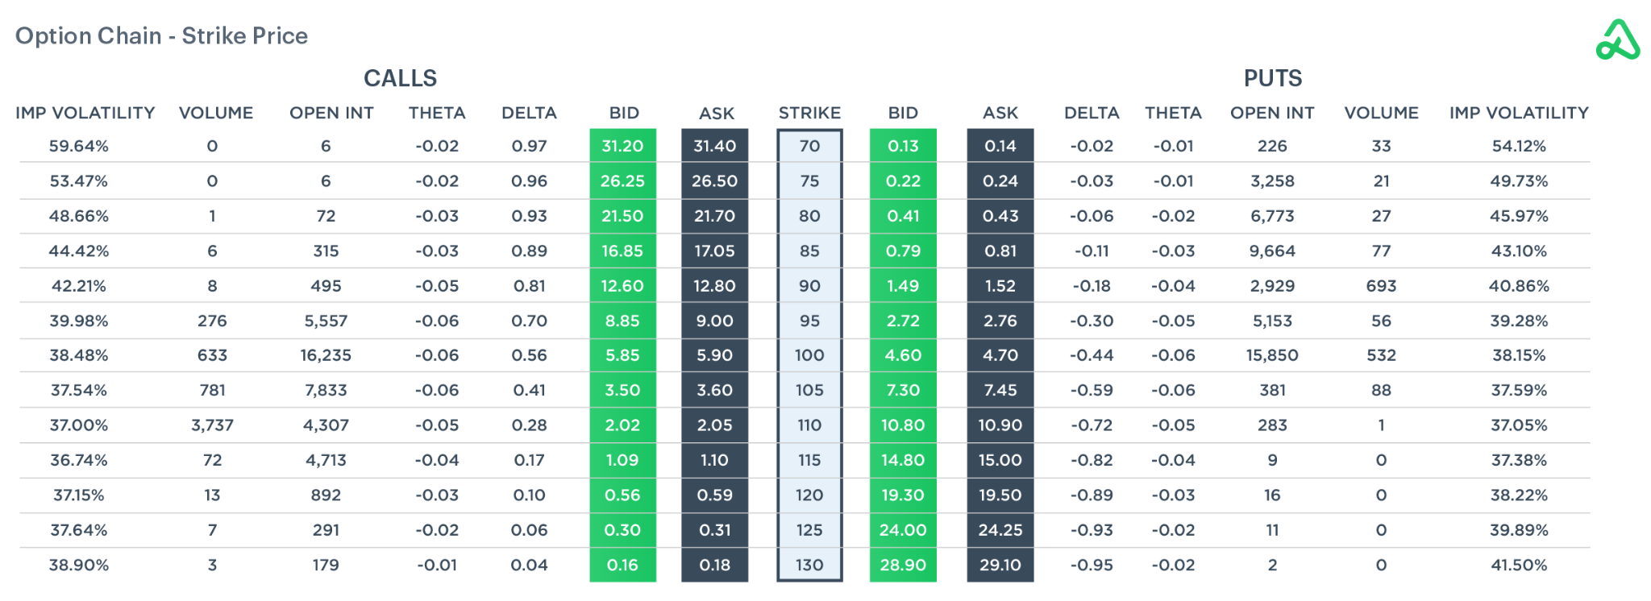

Slide 14
Theta Θ
Estimates the rate of change between price and time
Example:
A theta value is -0.5
This means that for every day that passes, the price of the option will go down by $0.50

Slide 15
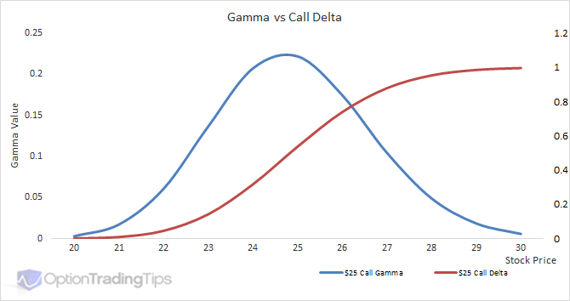
Gamma Γ
The derivative of Delta with respect to price
Basically how fast the Delta is changing at a price
Higher gamma values mean more risk. Given 2 stocks with equal delta values that each have price changes of $5, the one with a higher gamma will have a larger change in price

Slide 16
Vega v
Measures change in price based on change in implied volatility.
Forward-looking
Whereas delta measures in terms of actual price change, Vega measures in terms of theoretical price changes

Slide 17
Rho ⍴
Measures Price change in terms of Interest Rates

Slide 18
Other Lesser Known Greeks
Lambda, Epsilon, Vomma, Vera, Zomma, and Ultima
These are second and third derivatives of the other greeks we have talked about
These trends can also be seen by those with a keen eye by looking at the main Greeks, but are explicitly calculated and named to be these variables
Becoming increasingly more important in large algorithms because they are relatively easy to compute and can show hidden patterns

Slide 19

Akuna Options Education

Slide 20
Project Discussion/Work Time

